Slide 1


Exploring the Associations Between Sleep Disorders and Stress Using Social Media Analysis
Dataset: Twitter 400 GB
Team Members:
Willis Cheung #1
Justin Woods #2
Julian Mulia #3
ENSF 619.25
Machine Learning-Winter 2019
Notes:
This presentation in mandatory for all of the team, No presentation = 0% (Project)
The presentation length should be EXACTLY 150 seconds (2.5 minutes)
Please do not change the fonts!
Presentation time: April 1st , from 2:00 to 3:15pm, BI 587

Slide 2
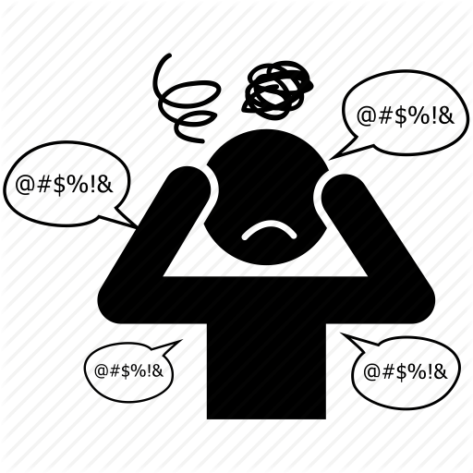
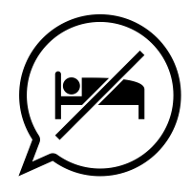
Exploring the Associations Between Sleep Disorders and Stress Using Social Media Analysis
Why analyzing the association between sleep disorders and stress?
Stressed?
Can’t Sleep?
Both?
Reason #1 Clinically emerging concepts highlight the need to treat patients with both co-existing symptoms differently
Reason #2 Sleeping disorders and excessive stress affect over 35% and 25% of Canadians respectively in their lifetime
Reason #3 50% of stress patients also suffer from sleep disorders and vice versa
ENSF 619.25
Machine Learning-Winter 2019
Notes:
Reason #1 Currently, stress and sleep disorders are treated under different pharmacotherapies emerging concepts highlight the need to treat patients with both co-existing symptoms differently
Reason #2 Sleeping disorders affect over 35% of Canadians. In addition, 25% of Canadians will experience excessive stress in their lifetime. It has been found that over 50% of stress patients also suffer from insomnia and vice versa

Slide 3
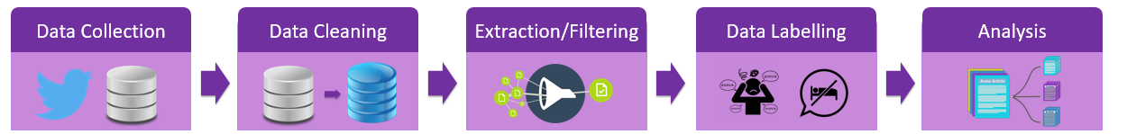
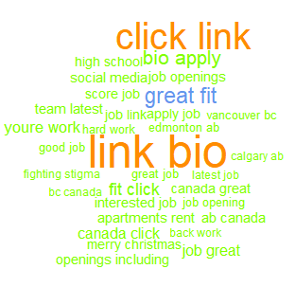
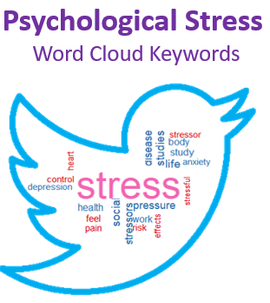
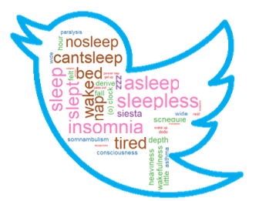
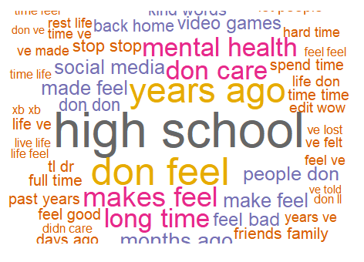
Exploring the Associations Between Sleep Disorders and Stress Using Social Media Analysis
Overall Methodology
Twitter Streaming API
~50 million tweets
Collected 3 months span
400 GB
Remove punctuation
Convert to lowercase
Negation substitution
Province correction
Emoji conversion
Location: Canada
Keywords Extraction
Keyword Filtering
Language
Originality
Spam Filtering
(P) Psychological Stress
(Z) Sleep Disorder
(B) Both
(U) Unclear
(N) Neither
Visualizations
Supervised:
Binary Naïve Bayes
Logistic Regression
Unsupervised
BDA
LDA
Spam Filtering
Psychological Stress
Word Cloud Keywords
Sleep Disorder
Word Cloud Keywords
Keyword Extraction
Reddit (stress)

Slide 4
Exploring the Associations Between Sleep Disorders and Stress Using Social Media Analysis
Overall Methodology
Twitter Streaming API
~50 million tweets
Collected 3 months span
400 GB
Remove punctuation
Convert to lowercase
Negation substitution
Province correction
Emoji conversion
Location: Canada
Keywords Extraction
Keyword Filtering
Language
Originality
(P) Psychological Stress
(Z) Sleep Disorder
(B) Both
(U) Unclear
(N) Neither
Visualizations
Supervised:
Binary Naïve Bayes
Logistic Regression
Unsupervised
BDA
LDA
Data Labelling
(P) Psychological Stress: “My depression and anxiety do not define me!”
(Z) Sleep Disorder: “Gotta be up for a flight in 6hrs and can't fall asleep"
(B) Both: “I am up at 10pm feeling depressed and waiting for a capsule to kick in”
(U) Unclear: “haha I’m depressed now lol”
(N) Neither: “We're hiring in Victoria BC Canada! Click the link in our bio to apply to this job and more”

Slide 5
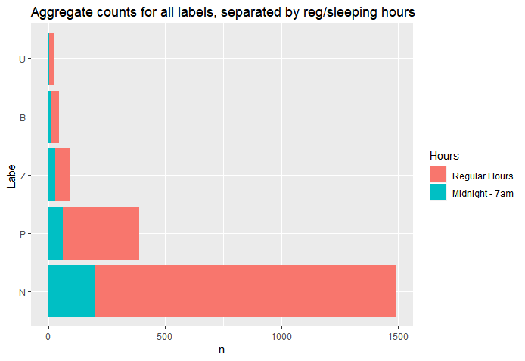
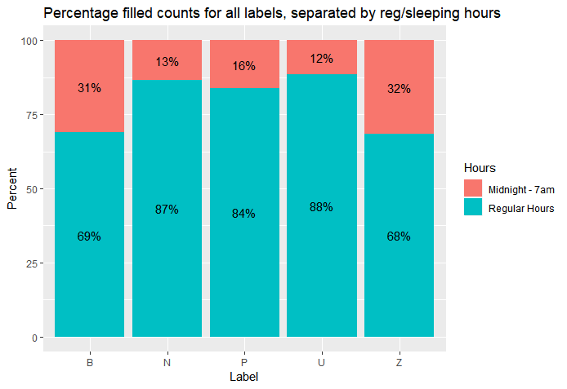
Exploring the Associations Between Sleep Disorders and Stress Using Social Media Analysis
Visualizations
Aggregate counts for all labels, separated by regular sleeping hours
Percentage filled counts for all labels, separated by regular sleeping hours
ENSF 619.25
Machine Learning-Winter 2019

Slide 6
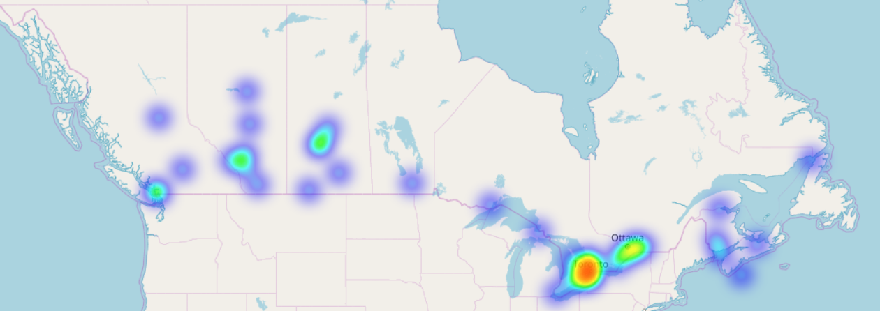
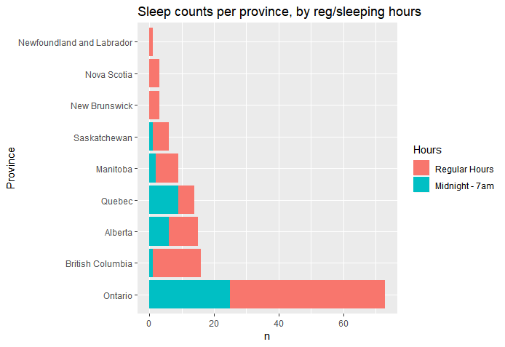
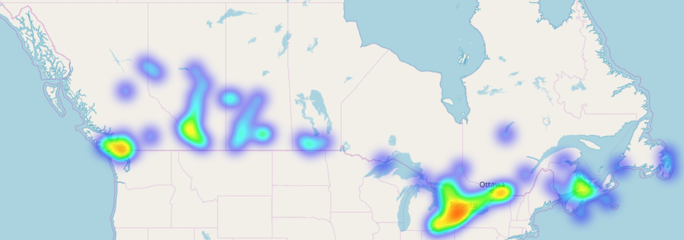
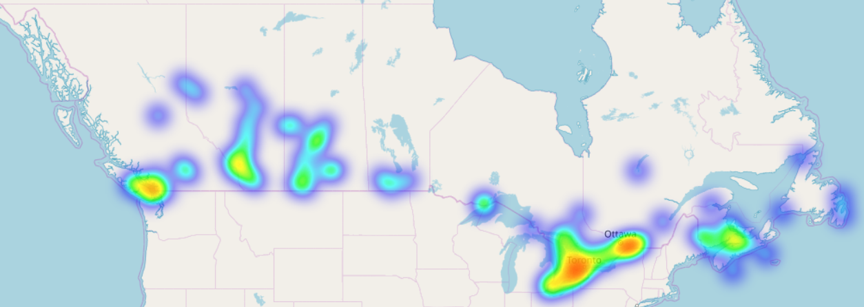
Exploring the Associations Between Sleep Disorders and Stress Using Social Media Analysis
Visualizations
Stress Heat Map
Sleep counts per province, by regular sleeping hours
Sleep Heat Map
Both Heat Map

Slide 7
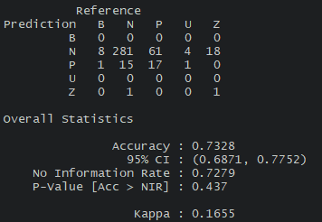
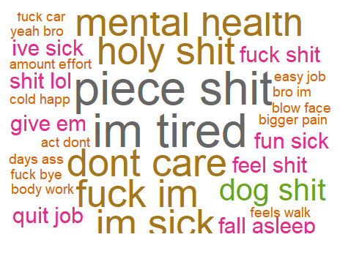
Exploring the Associations Between Sleep Disorders and Stress Using Social Media Analysis
Final Results [Supervised]
Logistic Regression Correlations
 | Higher Odds | Lower Odds
Stress | Wednesday, Thursdays and Sundays Higher odds of being stressed | A higher sentiment score had lower odds of the tweet indicating stress
 | The Manitoba, New Brunswick, Ontario and Quebec higher odds of being stressed | Posting between [12am-1pm] had lower odds of indicating stress
Sleep | Manitoba users had higher odds of indicating sleep disorders
 | Posting between [1-4am], [5-7am] had higher odds of indicating a sleep disorder | Users with higher friends’ count had lower odds of indicating sleep disorders
Binary Naïve Bayes – test predictions
Stress Labelled Bigram Word Cloud
ENSF 619.25
Machine Learning-Winter 2019

Slide 8
Exploring the Associations Between Sleep Disorders and Stress Using Social Media Analysis
Final Results [Unsupervised]
LDA Topics
 | Topic 1 | Topic 2 | Topic 3 | Topic 4 | Topic 5
1 | Life | Heart | Cold | Shit | School
2 | Time | Coffee | Day | Fuck | Rest
3 | Job | Mental | Today | Fucking | New
4 | Years | Love | Hours | Hate | High
5 | Ago | Health | Late | People | Year
About → | Work/Life | Positive Sentiment | Weather | Stress Sentiment | School
BTM Topics
 | Topic 1 | Topic 2 | Topic 3 | Topic 4 | Topic 5
1 | Life | Cold | Emoji_red_heart | Emoji_Pizza | Mental
2 | Time | Coffee | School | Wind | Health
3 | School | Emoji_snowflake | Avenue | Pressure | Stigma
4 | Cold | Emoji_heavy_minus | Alarm | Rain | Fighting
5 | Shit | snow | Institution | Forecast | Alcohol Awareness
About → | Complaints on school/life | Complaints on weather/cold | Unknown | Weather forecast | Support Talks

Slide 9
Exploring the Associations Between Sleep Disorders and Stress Using Social Media Analysis
Final Results [Unsupervised]
LDA Topics
 | Binary Naïve Bayes |  | Log Regression
 | Sleep | Stress | Sleep | Stress
Precision | 0.67 | 0.53 | 0.67 | 0.46
Recall | 0.21 | 0.21 | 0.1 | 0.11
F-score | 0.324 | 0.3 | 0.17 | 0.18

